Slide 1
Node.js for Architects
Oscar Renalias, JavaSlava 2013

Slide 3
Server-side

Slide 4

Javascript
Dynamic
Weakly typed
Closures and functions
Objects and prototypes
Standardized as ECMAScript

Slide 5
Single threaded
Notes:
Unashamedly inspired by: http://www.slideshare.net/sergimansilla/big-app-design-for-nodejs (slide 11)

Slide 6
Event-based
Event
Event
Callbacks
Event
Loop
Event

Slide 8
Event-based, asynchronous
Non-blocking IO
Callbacks

Slide 9
Why?

Slide 10
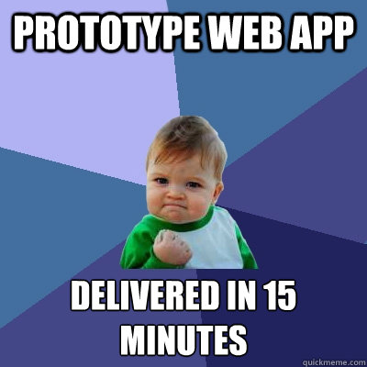
Rapid prototyping and development

Slide 11
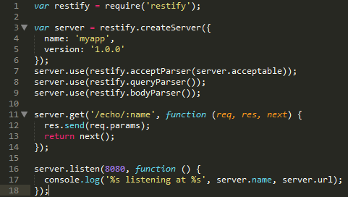
RESTful services with node-restify

Slide 12
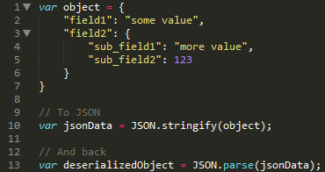
No-fuss, native JSON handling
Notes:
JSON is Javascript’s native serialization format
Integrates very well with things like JSON-based APIs, MongoDB, etc – things that speak JSON natively

Slide 13
Development Toolset

Slide 14
How
Modularization
Awesome package management
Development automation
Mature and innovative frameworks

Slide 15
Modularization
Uses the CommonJS module format

Slide 16

Package management

Slide 17
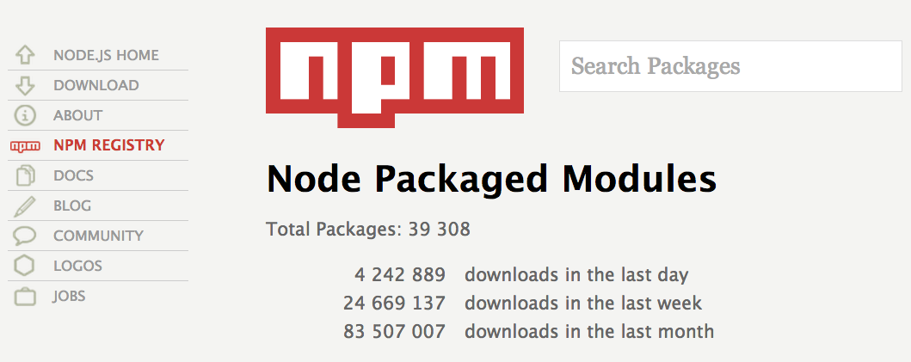
Community modules
http://npmjs.org

Slide 18


Automation
Notes:
Grunt = Ant
Yeoman = Maven, some parts of it including archetypes (“generators” in Yeomanese)

Slide 19
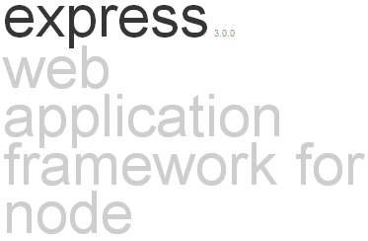
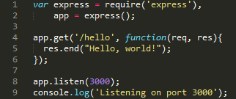
Express
Minimal web application framework
Additional features are provided as modules or middleware: template engines, models, authentication and authorization, etc

Slide 20
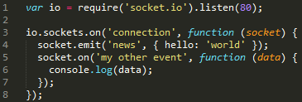
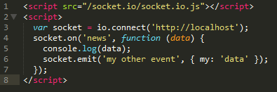
Socket.io
Provides support for server-initiated push events using WebSockets, Ajax polling, Iframe, JSONP or Flash-based channels
Transparent for both clients and servers
Can run standalone or integrated with Express
SERVER
CLIENT

Slide 21
Meteor
Framework for real-time collaborative web applications

Slide 22
When to use Node.js
Real-time web apps with Socket.io and Meteor
REST+JSON APIs
Single-page web apps

Slide 23
When not to use Node.js
CPU-bound applications
Boring CRUD-type web apps
Notes:
Node.js frameworks don’t make it neither easier nor more difficult to write traditional web apps; Node.js and its frameworks just simply make no difference here

Slide 24

Enterprise readiness?
Notes:
Image credit: http://www.allmystery.de/i/bk33NhA_ayZYgl_USS_Enterprise_NCC_1701_A_by_cb93.jpg

Slide 25
Maturity
Under development for X years
1.0 coming soon
39000 modules via npm
Awesome community
Notes:
https://groups.google.com/d/topic/nodejs/9afurRCTlOc/discussion

Slide 26
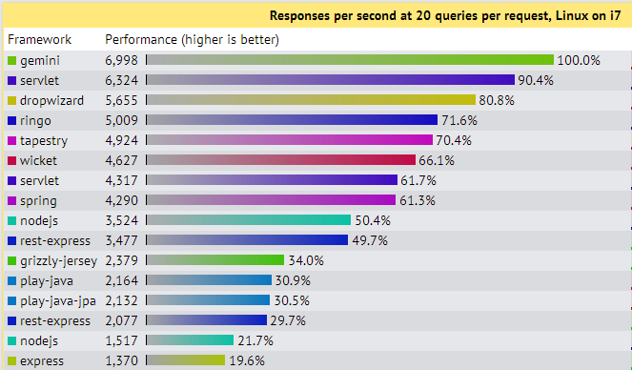
Performance
Source: http://www.techempower.com/benchmarks/

Slide 27
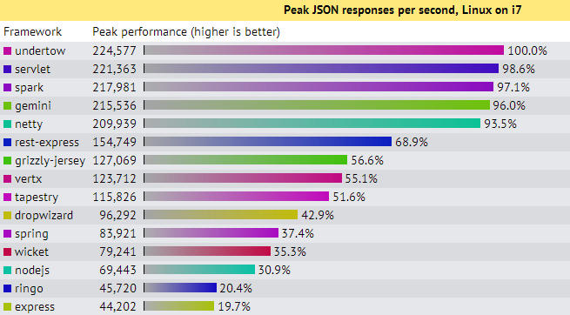
More Performance
Source: http://www.techempower.com/benchmarks/

Slide 28
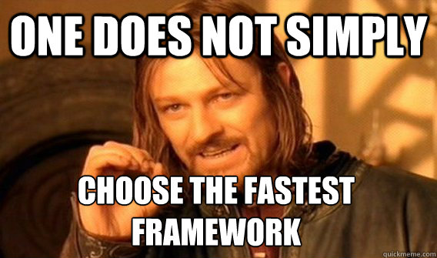
Not the fastest; does it always matter?

Slide 29

Javascript
Like Java, with easier syntax and no types
Weird shit
Notes:
Image source: http://drtom.ch/talks/2012/06/jazoon/images/tip_of_the_iceberg.jpg
Original idea: https://speakerdeck.com/anguscroll/the-politics-of-javascript

Slide 30
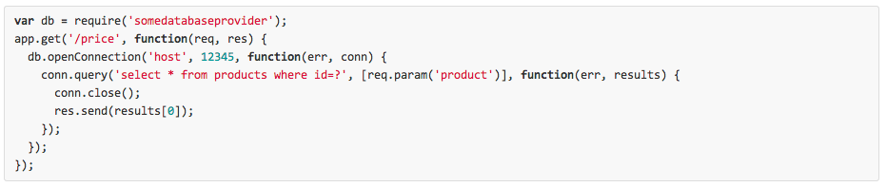
Spaghetti callback
Promises (Q, Q-IO)
ECMAScript 6, yield/continuations

Slide 31
Big teams, big codebases
There is no substitute for a compiler
Extreme care required from developers and the people who design the development processes
No proven success of Node.js applications in the enterprise world, yet

Slide 32
Infrastructure, Cloud & PaaS
Runs on Windows, Linux and OS X
Clouds with Node.js specific support: Heroku, Nodejitsu, Joyent Smartcloud, Amazon Elastic Bean Stalk

Slide 33

Commercial Support
Joyent is the corporate steward of Node.js, the world’s best runtime for today's data-intensive, real-time applications. Joyent offers exclusive debugging and performance analysis tools for Node.js applications.

